Slide 1
PROJECT TITLE
CAPSTONE PROJECT
Presented By: ASHOK S
Student Name : ASHOK S
College Name : KALASALINGAM ACADEMY OF RESEARCH AND EDUCATION
Department : COMPUTER SCIENCE AND ENGINEERING

Slide 2
OUTLINE
Problem Statement
Technology used
Wow factor
End users
Result
Conclusion
Git-hub Link
Future scope

Slide 3
Problem Statement
As the demand for secure communication and data privacy grows, conventional encryption techniques tend to be detected and prevented by attackers. What is needed is a steganography application that allows users to hide sensitive data in digital media (e.g., images, audio, or video) so that it is not detectable by unauthorized parties. The software must have an easy-to-use interface for encoding and decoding secret messages with minimal distortion of the carrier file. It must also include robust encryption methods to provide security, steganalysis resistance, and support for various file formats for flexibility in practical use.

Slide 4
Technology used
Libraries & Platforms
Libraries
HTML
CSS
JAVASCRIPT
Platform:
VISUAL STUDIO CODE
Microsoft edge browser

Slide 5
Wow factors
Contemporary Dark-Themed GUI – Minimalist, high-end design interface with dynamic, real-time feedback and an easy-on-the-eye color palette for making steganography simple even for technically-inclined, non-IT users.
Dual Input System – Enables direct user input or input via uploading of a file with automatic message-length validation to see if it suits the capacity that the image carries.
Improved Security – Offers password protection for both encoding and decoding, coupled with strong error management, maintaining the original quality of the image.
Intelligent Message Handling – Minimizes the use of pixels and keeps message length preserved automatically to avoid overflow, upholding data integrity. This combination of security with user-friendliness differentiates it from standard steganography applications that generally have to choose one over the other.

Slide 6
End users
Privacy-Focused Individuals
Education Sector
Cybersecurity Professionals
Digital Rights Advocates

Slide 7
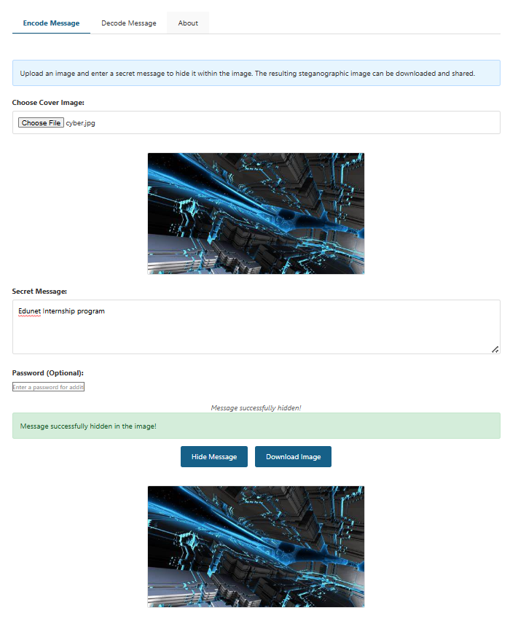
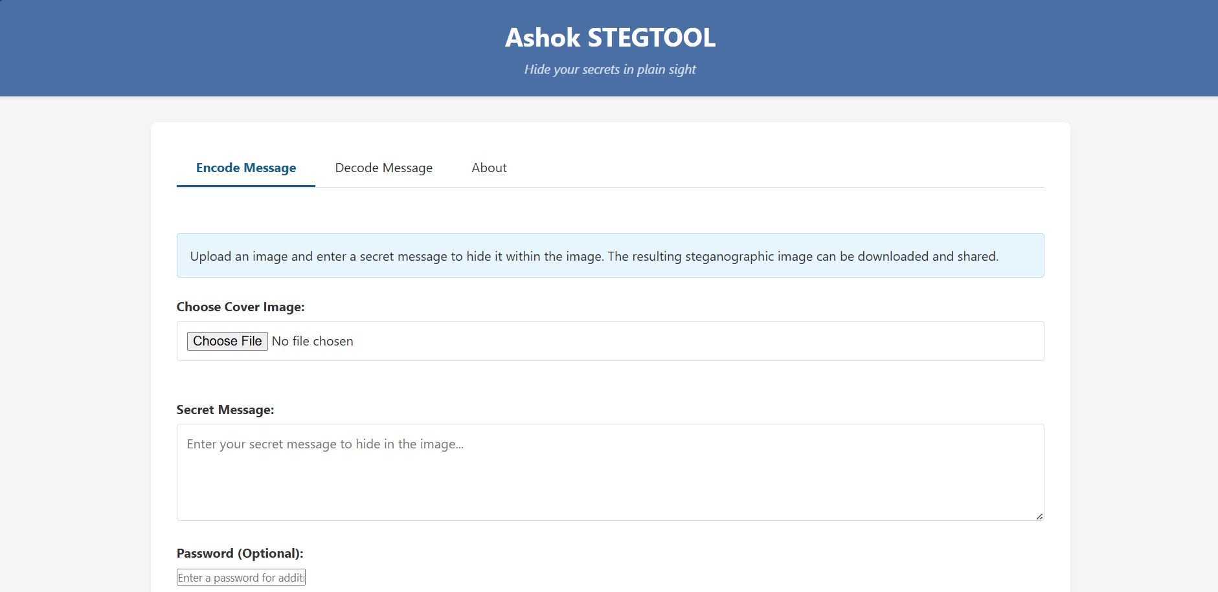
Results

Slide 8
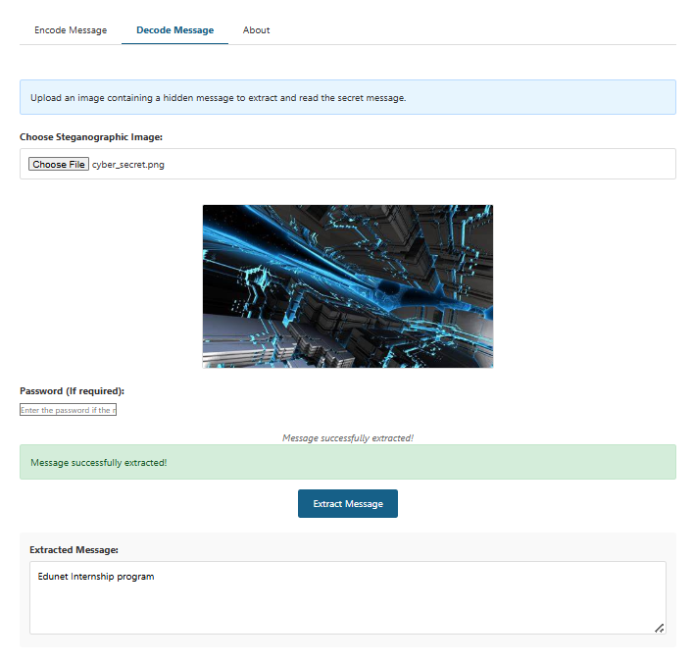
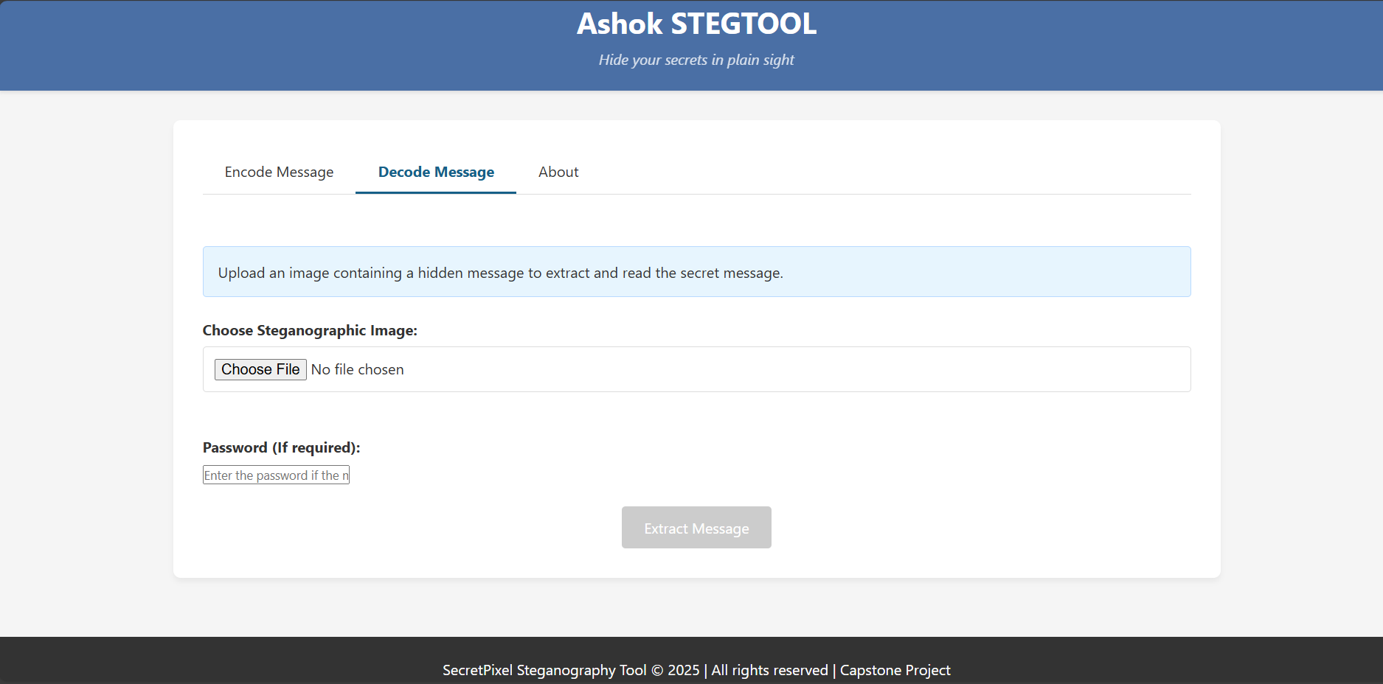
Results

Slide 9
Conclusion
The tool for steganography designed is a safe and easy-to-use solution for hiding confidential data in digital media.
With its sleek dark GUI, dual input mechanism, advanced security features, and intelligent message handling, the tool guarantees a smooth experience for technical and non-technical users alike. With its ability to preserve data integrity and avoid detection, it presents a strong alternative to conventional encryption solutions.
This software has important uses in privacy protection, cybersecurity, education, and digital rights campaigning, and thus it is an important resource for secure communication in the modern digital era.

Slide 10
GitHub Link
https://github.com/Ashok0908/Edunet-Internship.git

Slide 11
Future scope(optional)
Enhanced Security : Implementation of advanced encryption algorithms (AES/RSA) alongside steganography, and support for hiding messages in audio/video files.
Advanced Features : Integration of blockchain for message verification, cloud storage support for secure image sharing, and AI-powered steganography detection resistance.
Cross-Platform Development : Mobile application development (Android/iOS) and web-based version with real-time collaboration features.

Slide 12
THANK YOU

